Slide 1
LAN Technologies
ETHERNET: the term Ethernet refers to the family of LAN products covered by the IEEE 802.3 standard that defines what is commonly known as the CSMA/CD protocol (Carrier Sense Multiple Access Collision Detect).
When a host wants to transmit over the network, it first checks for the presence of a digital signal on the wire. If all is clear the host will proceed with its transmission.
The host continuously monitors the wire to make sure no other hosts begin transmitting. If the host detects another signal on the wire, it sends out an extended jam signal by waiting a while before attempting to transmit again. Backoff algorithms determine when the colliding stations can transmit. If collisions keep occurring after 15 tries, the nodes attempting to transmit will then time out.

Slide 2
LAN Technologies
Three data rates are currently defined for operation over optical fiber and twisted pair cables.
10Mbps- 10BASE-T Ethernet
100Mbps-Fast Ethernet
1000Mbps-Gigabit Ethernet
Ethernet LAN consists of network nodes (Data terminal equipment) and interconnecting media (Data communication equipment). The current Ethernet media uses UTP, STP and fiber optic cable.

Slide 3
LAN Technologies
The MAC layer in Ethernet controls the nodes access to the network media and is specific to the individual protocol. All IEEE 802.3 MACs must meet the same basic set of logical requirements regardless of whether they include one or more of the defined optional protocol extensions.
Ethernet addressing uses the Media Access Control (MAC) address burned into each and every Ethernet Network Interface Card (NIC). The MAC or hardware address is a 48-bit address written in hexadecimal format.
The MAC address contains the Organizationally Unique Identifier (OUI) (24bits) which is assigned by the IEEE to an organization. The organization in turn assigns a globally administered address (24 bits) that is unique to each adapter it manufactures.

Slide 4
LAN Technologies
The requirement for basic communication between two network nodes is that both MACs must support the same transmission rate. The Ethernet MAC sublayer performs functions such as data encapsulation, including frame assembly before transmission, frame parsing/error detection during and after reception, media access control, initiation of frame transmission and recovery from transmission failure.
The 802.3 physical layer is specific to the transmission data rate, the signal encoding and the type of media interconnecting the two nodes.
Frame transmission in Ethernet will depend on whether the MAC is operating in half-duplex or full duplex mode. The IEEE 802.3 standard currently requires that all Ethernet MAC support half-duplex operation in which the MAC can be either transmitting or receiving a frame, but it cannot be doing both simultaneously. Full duplex operation is an optional MAC capability that allows the MAC to transmit and receive frames simultaneously.

Slide 5
The Basic Ethernet Frame Format
The IEEE 802.3 standard defines a basic data frame format that is required for all MAC implementation, plus other several additional optional formats that are used to extend the protocol basic compatibility. The basic data frame format contains the seven fields shown in the figure below.
PRE | SFD | DA | SA | Length/Type | Data | pad | FCS
PREAMBLE: consists of 7 bytes. The PRE is an alternating pattern of ones and zeros that tells receiving stations that a frame is coming and that provides a means to synchronize the frame reception portions of receiving physical layers with the incoming bit stream
Start of Frame Delimiter (SFD): consists of 1 byte. It is an alternating pattern of ones and zeros ending with two consecutive 1-bits indicating that the next bit is the left most bit in the left most byte of the destination address.
Destination Address (DA): consists of 6 bytes. It identifies which station should receive the frame Source address (SA): consists of 6 bytes. The SA field identifies the sending station. Length/ type: consists of 4 bytes. This field identifies the particular type of frame being sent. Data;
Frame Check Sequence: contains cyclic redundancy check (CRC) value, which is created by the sending MAC and is recalculated by the receiving MAC to check for damaged frames.

Slide 6
HALF DUPLEX TRANSMISSION (CSMACD)/FULL DUPLEX TRANSMISSION (optional)
Full duplex operation is an optional MAC capability that allows simultaneous 2-way transmission over point-to-point links. It uses two pairs of wires instead of one wire pair like half duplex. It is much simpler because it does not involve media contention, no collisions, no need to schedule retransmission. The result is more time available for transmission, effective doubling of the link bandwidth because each link can support full rate simultaneous two way transmission.
Transmission can begin as soon as frames are ready to send. The only restriction is that there must be a minimum length inter-frame gap between successive frames and each frame must conform to Ethernet frame format standard

Slide 7
HALF DUPLEX TRANSMISSION (CSMACD)/FULL DUPLEX TRANSMISSION (optional)
Full duplex operation requires concurrent implementation of the optional flow-control capability that allows a receiving node that is becoming congested to request the sending node to stop sending frames for a selected short period of time.
If the congestion is relieved before the request wait has expired, a second pause frame with a zero time to wait value can be sent to request resumption of transmission. The pause frames are assigned a reserved destination address to ensure that an incoming pause frame is never forwarded to upper layers.

Slide 8
HALF DUPLEX TRANSMISSION (CSMACD)/FULL DUPLEX TRANSMISSION (optional)
Frame reception is essentially the same for both half duplex and full duplex operations except that full duplex MACs must have separate frame buffers and data paths to allow for simultaneous frame transmission and reception.
The destination address of the received frame is checked and matched against the stations address list (MAC address, group address, broadcast address) to determine whether the frame is destined for that station.
If an address match is found the frame length is checked and the received FCS is compared to the FCS that was generated during frame reception. If the frame length is okey and there is an FCS match , the frame type is determined by the contents of the length/type field. The frame is then parsed and forwarded to the appropriate upper layer.

Slide 9
Ethernet Physical Layer
Ethernet was first implemented by a group called DIX ( Digital, Intel and Xerox). They created and implemented the first Ethernet LAN specification which the IEEE used to create the IEEE 802.3 Committee. This was a 10Mbps network that ran on coaxial and then eventually twisted pair and fiber physical media. The IEEE extended the 802.3 committee to two new committees known as 802.3u (Fast Ethernet) and 802.3ab ( Gigabit Ethernet on category 5) and then finally 802.3ae ( 10Gbps over fiber and coaxial).
Because Ethernet devices implement only the bottom two layers of the OSI protocol stack, they are typically implemented as Network Interface Cards (NICs) that plug into the host devices motherboard. The different NICs are identified by a 3-part product name that is based on the physical layer attributes. The naming convention is a concatenation of three terms indicating the transmission rate, transmission method and the media type/signal encoding e.g

Slide 10
Ethernet Physical Layer
10BASE2- 10 Mbps, baseband, almost 200 meters, thinnet
10BASE5- 10 Mbps, baseband, 500 meters, thicknet
10BASE-T-10Mbps, baseband, over two twisted pair cable, each device must connect into a hub or a switch.
100BASE-F- 100Mbps, baseband,
100BASE-TX 100Mbps, use category 5, 6 or 7 UTP
100BASE-FX-1000Mbps, use fiber cabling multimode fiber
1000BASET, category 5, upto 100 meters
1000BASELX-single mode fiber, from 3km – 10 km
The EIA/TIA ( Electronic Industries Association and the Telecommunications Industry Alliance) is the standards body that creates the physical layer specifications for Ethernet.
Each Ethernet cable type that is specified by the EIA/TIA has inherent attenuation which is defined as the loss of strength as it travels the length of a cable and is measured in decibels(dB). The cabling used in corporate and home markets is measured in categories. A higher quality cable will have a higher rated category and lower attenuation.

Slide 11
Token Ring
IBM originally developed the token ring network in the 1970’s. It is still IBM’s primary local area network technology. The IEEE 802.5 specification is almost identical to and completely compatible with IBM’s Token ring network.
Token passing networks move a small frame called a token around a network. Possession of the token grants the right to transmit. If a node receiving the token has no information to send, it passes the token to the next end station.
Each station can hold the token for a maximum period of time. If a station possessing the token has information to transmit, it seizes the token, alters 1 bit of the token (hence turning the token into a start of frame sequence). It then appends the information that it wants to transmit and sends the information to the next station on the ring.

Slide 12
Token Ring
While the information frame is circling the ring no token is on the network, which means that other stations wanting to transmit must wait. Therefore collisions cannot occur in token ring networks.
The information frame circulates the ring until it reaches the intended destination station, which copies the information for further processing. The information frame continues to circle the ring and is finally removed when it reaches the sending station. The sending station can check the returning frame to see whether the frame was seen and subsequently copied.
Token ring networks use sophisticated priority systems that permits certain user-designated high priority stations to use the network more frequently.

Slide 13
Token Ring Fault Management Mechanisms
Token ring networks employ several mechanisms for detecting and compensating for network faults. One station in the token ring is selected to be the active monitor. This station, which potentially can be any station on the network, acts as a centralized source of timing information for the other ring stations and performs a variety of ring-maintenance functions.
One of these functions is the removal of continuously circulating frames from the ring. When a sending device fails, its frame may continue to circle the ring. This can prevent other stations from transmitting their own frames and essentially can lock up the network. The active monitor can detect such frames, remove them from the ring and generate a new token.

Slide 14
Token Ring Fault Management Mechanisms
A token ring algorithm called beaconing detects and tries to repair certain network faults. Whenever a station detects a serious problem with the network (such as a cable break) it sends a beacon frame, which defines a failure domain.
This domain includes the station reporting the failure; it’s nearest active upstream neighbor (NAUN) and everything in-between. Beaconing initiates a process called auto-reconfiguration, in which nodes within the failure domain automatically perform diagnostics in an attempt to reconfigure the network around the failed areas. Physically the multistation access unit (MSAU) can accomplish this through electrical reconfiguration.

Slide 15
FIBER DISTRIBUTED DATA INTERFACE(FDDI)
The FDDI offers higher speed data communications than Ethernet and token ring. It supports up to 500 nodes on a single fiber optic cable segment. The ultimate performance capability is transmission speed of 450,000 packets per second. Data traffic consisting of voice, video and real-time applications all are supported by FDDI.
FDDI is similar to the token ring access method in that it uses token passing for network communications. It differs from standard token ring in that a timed token access method is used.

Slide 16
FIBER DISTRIBUTED DATA INTERFACE(FDDI)
An FDDI token travels along the network ring from node to node. If a node does not need to transmit data, it picks up the token and sends it to the next node. If the node possessing the token does need to transmit, its allowed to send as many frames as desired for a fixed amount of time called the Target Token Rotation Time (TTRT).
Once anode transmits a frame, the frame goes to the next node on the network ring. Each node determines whether the frame is intended for it, and each node checks the frame for errors. I f the node is the intended target; it marks the frame as having been read. Also if any node detects an error, it marks a status bit in the frame to indicate an error condition. When the frame arrives back at the originating node, it’s read to determine whether or not the target node received it. The frame is also checked for errors. If an error is detected, the frame is retransmitted. If no errors are found the frame is removed from the ring by the originating node.

Slide 17
FDDI Error Management
FDDI nodes monitor for two types of network error situations. Long periods of no activity and long periods where the token is not present. In the first instance the token is presumed to be lost while in the second instance, a node is assumed to be transmitting continuously.
If either error condition is present, the node that detects the error sends a stream of specialized frames called claim frames. The claim frames contain a proposed TTRT value. The first node stops transmitting and the next node on the ring compares its proposed TTRT value with the value sent by the previous node. After the comparison, it sends the lower of the TTRT values in its claim frames to the next node.
By the time the last node is reached, the smallest TTRT value has been selected. At this point the ring is initialized by transmitting the token and the new TTRT value to each node, until the last node is reached.

Slide 18
FDDI Physical Connection
FDDI is used with single-mode or multi-mode fiber optic cable. Single-mode cable allows one bundle of light to enter the fiber whereas multi-mode cable allows many bundles of light to enter at a given time.
Single-mode fiber is used for network backbones where data must travel long distances. Multi-mode fiber is used for desktop workgroup applications that involve shorter transmission distances.
FDDI networks have data redundancies, which gives them high reliability. Redundancy is accomplished by using two network rings. One ring is defined as the primary cable run for information transmission. The secondary ring provides a backup route for transmitted information, should the primary ring be broken. Data on the secondary ring travel in the opposite direction as data on the primary ring.

Slide 19
FDDI Physical Connection
Two classes of nodes connect to FDDI. Class A nodes are attached to both network rings. They consist of network equipment such as hubs and routers.
They have the ability to reconfigure the ring to enable fault correction in the event of network failure. Class B nodes connect to the FDDI network through Class A devices. They attach to the primary ring only. They include servers, workstations and pc’s.

Slide 20
Wireless LANs
WLANs typically run half-duplex (two-way communication using the same frequency to both transmit and receive) communication-everyone is sharing the same bandwidth and only one user is communicating at a time but there has been improvements with time.
Wireless LANs use radio frequencies that are radiated into the air from an antenna that creates radio waves. These waves can be absorbed, refracted or reflected by walls, water and metal surfaces resulting in low signal strength. Because of this vulnerability to environmental factors, it’s apparent that wireless will never offer the same robustness as a wired network can.
802.11 specifications were developed so that there would be no licensing required in most countries to ensure the user the freedom to install and operate without any licensing or operating fee. Also that all computers should be able to communicate wirelessly without configuring much.

Slide 21
Wireless LANs
Wireless agencies and standards include IEEE that creates and maintains operational standards, Federal Communications Commission (FCC) regulates the use of wireless devices in the US, Wi-Fi alliance that promotes and tests for WLAN interoperability and WLAN Association that educates and raises consumer awareness regarding WLANS.
WLANs are governed by 802.11 standards, there are many others coming up. IEEE 802.11 was the first at 1 and 2Mbps. It runs in the 2.4GHz radio frequency 802.11b, operates in the 2.4 GHz unlicensed radio band that delivers a maximum data rate of 11Mbps. It uses CSMA/CA, which is also called Request to send, clear to send (RTS/CTS) because of the way that hosts must communicate to the access point (AP). For every packet sent,, an RTS/CTS and acknowledgement must be received

Slide 22
Wireless LANs
802.11g standard was ratified in 2003 and is compatible with 802.11b. runs in 2.4GHz range with a maximum data rate of 54Mbps. If you have four users running 802.11g cards and one user starts using an 802.11b card, everyone connected to the same access point is then forced to run the 802.11b (disadvantage).
To optimize performance it is recommended that you disable the 802.11b only modes on all your access points.

Slide 23
Wireless LANs
802.11a standard operates at 5GHz range and delivers 54 Mbps maximum data rate. This standard is immune to interference from devices that operate in the 2.4GHz band, like microwave ovens, cordless phones and Bluetooth devices. 802.11a isn’t backward compatible with 802.11b because they are different frequencies.
However 802.11a can work in the same physical environment without interference from 802.11b users. The 802.11a products allow the person operating at 54Mbps to shift to 48Mbps, 36Mbps, 24Mbps,18Mbps, 12Mbps, 9Mbps and finally still communicate farthest from the access point at 6Mbps. There is also an extension of the 802.11a specifications called 802.11h that contain other improvements

Slide 24
Wireless LANs
Wireless NICs: Mostly built into the laptop, the wireless NIC is not visible because there is no requirement to connect a cable to it. There are also many USB options available.
Wireless Access Points: An access point connects wireless clients to the wired LAN. Client devices do not typically communicate directly with each other, they communicate with the AP. In essence an access point converts the TCP/IP data packets from their 802.11 frame encapsulation format in the air to the 802.3 Ethernet frame format on the wired Ethernet network. Wireless routers perform the role of access point, Ethernet switch, router and gateway all in one.

Slide 25
Wireless LANs
CSMA/CA: Access points oversee a distributed coordination function (DCF) called Carrier Sense Multiple Access with Collision Avoidance (CSMA/CA).
Devices on a WLAN must sense the medium for signals and wait until the medium is free before sending. If an access point receives data from a client station it sends an acknowledgement to the client that the data has been received.
This acknowledgement keeps the client from assuming that a collision occurred and prevents a data retransmission by the client.

Slide 26
Token Passing
In its simplest form of operation each station on the ring receives each frame and then passes it on (retransmits) to its neighbor. If that station recognizes its address as the destination address, it copies the frame in addition to retransmitting it. The original sending station takes its own frame off the ring as it returns to that station after one cycle around the ring.
In a single token procedure the sending station then passes control to the next station by issuing a token after receipt of its own frame.
In the case of token passing a station must wait until it receives permission to do so. This access time takes, on the average one-half a cycle time from the time a station is ready to transmit ( why is this so?)

Slide 27
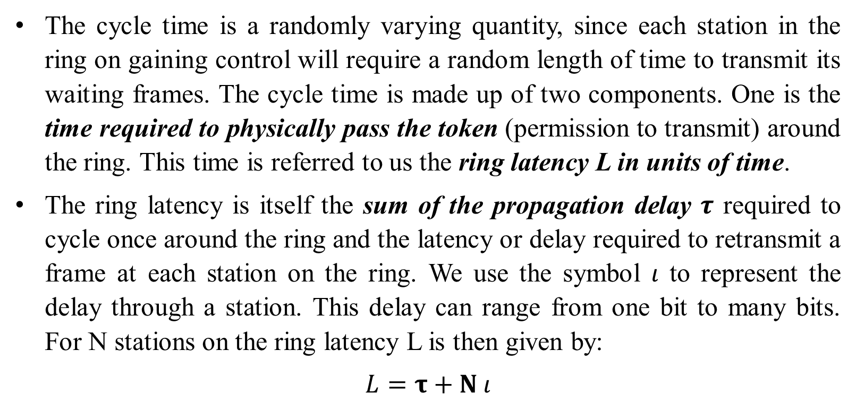
Token Passing
The cycle time is a randomly varying quantity, since each station in the ring on gaining control will require a random length of time to transmit its waiting frames. The cycle time is made up of two components. One is the time required to physically pass the token (permission to transmit) around the ring. This time is referred to us the ring latency L in units of time.
The ring latency is itself the sum of the propagation delay $τ$ required to cycle once around the ring and the latency or delay required to retransmit a frame at each station on the ring. We use the symbol $ι$ to represent the delay through a station. This delay can range from one bit to many bits. For N stations on the ring latency L is then given by:
$$L=τ+N ι$$

Slide 28
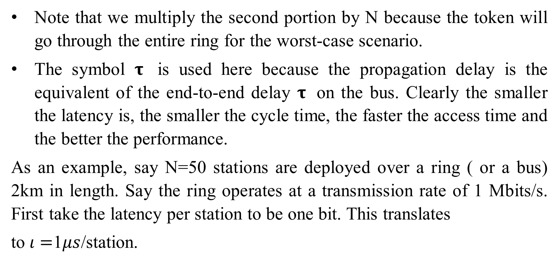
Token Passing
Note that we multiply the second portion by N because the token will go through the entire ring for the worst-case scenario.
The symbol $τ$ is used here because the propagation delay is the equivalent of the end-to-end delay $τ$ on the bus. Clearly the smaller the latency is, the smaller the cycle time, the faster the access time and the better the performance.
As an example, say N=50 stations are deployed over a ring ( or a bus) 2km in length. Say the ring operates at a transmission rate of 1 Mbits/s. First take the latency per station to be one bit. This translates
to $ι=$1$μs$/station.

Slide 29
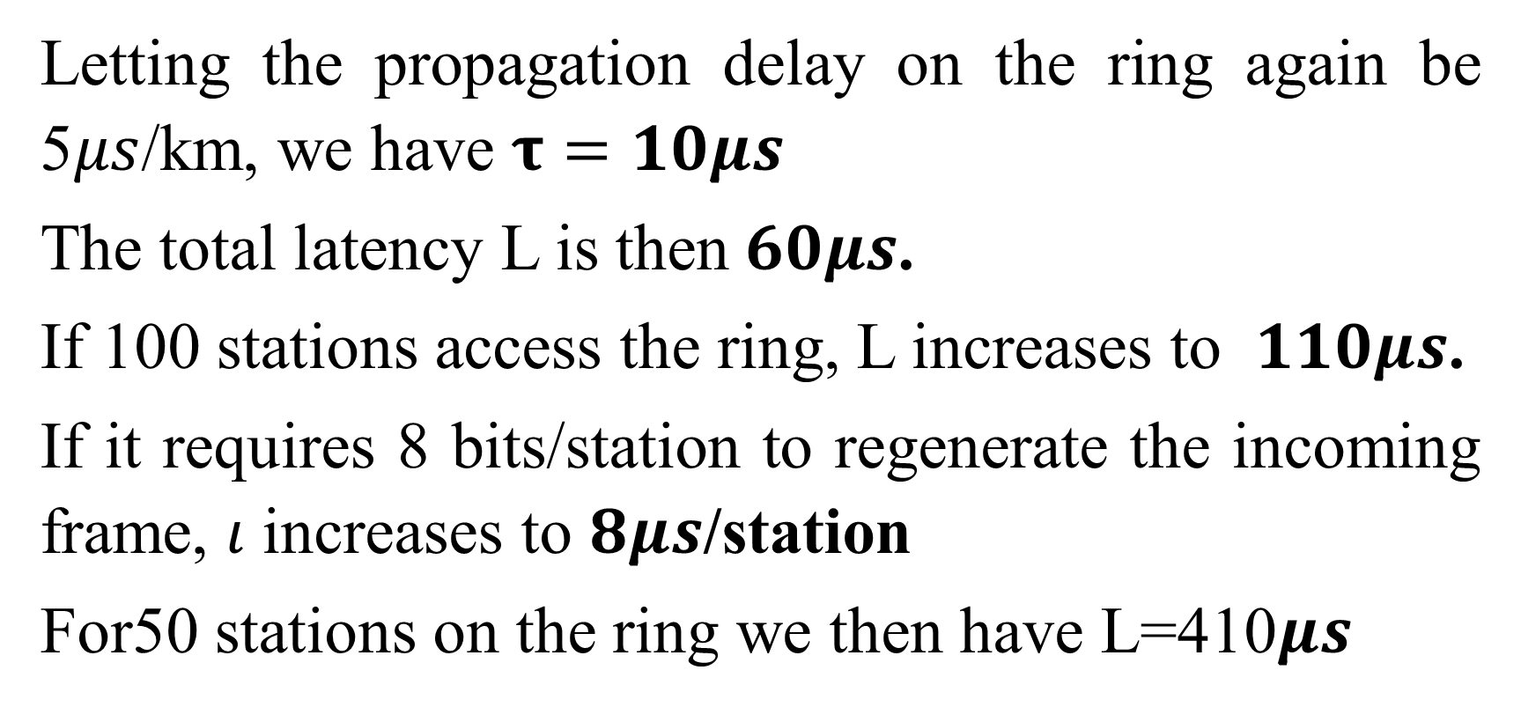
Token Passing
Letting the propagation delay on the ring again be 5$μs$/km, we have $τ=10μs$
The total latency L is then$60μs$.
If 100 stations access the ring, L increases to $110μs$.
If it requires 8 bits/station to regenerate the incoming frame, $ι$ increases to $8μs$/station
For50 stations on the ring we then have L=410$μs$

Slide 30
As the ring transmission rate or capacity C increases, the latency per station ι decreases, as does the ring latency L.
We mentioned above that the average cycle time, or time required for each station to access the ring once is made up of two components. One is the latency L, discussed. The other is the average time required for each station to transmit its waiting frames once it receives permission to do so. Call this time tj for the jth station, j=1,2,3…..,N.
The cycle time tc can then be represented as shown in the figure 1 below:

Slide 31
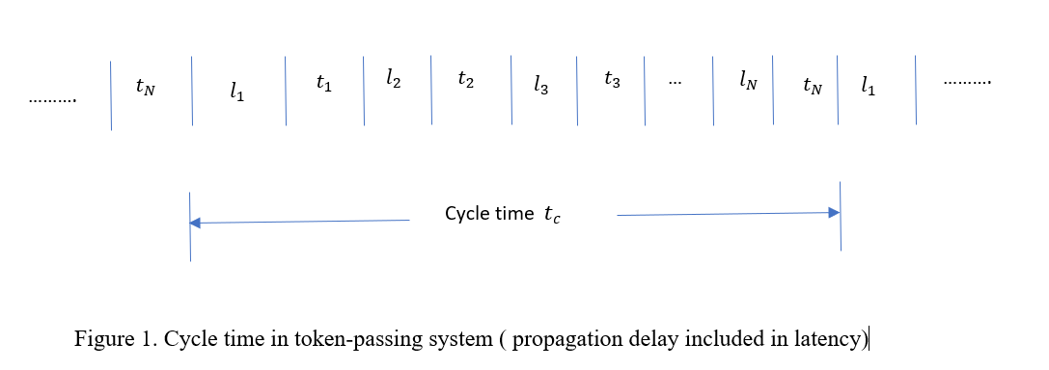

Slide 32
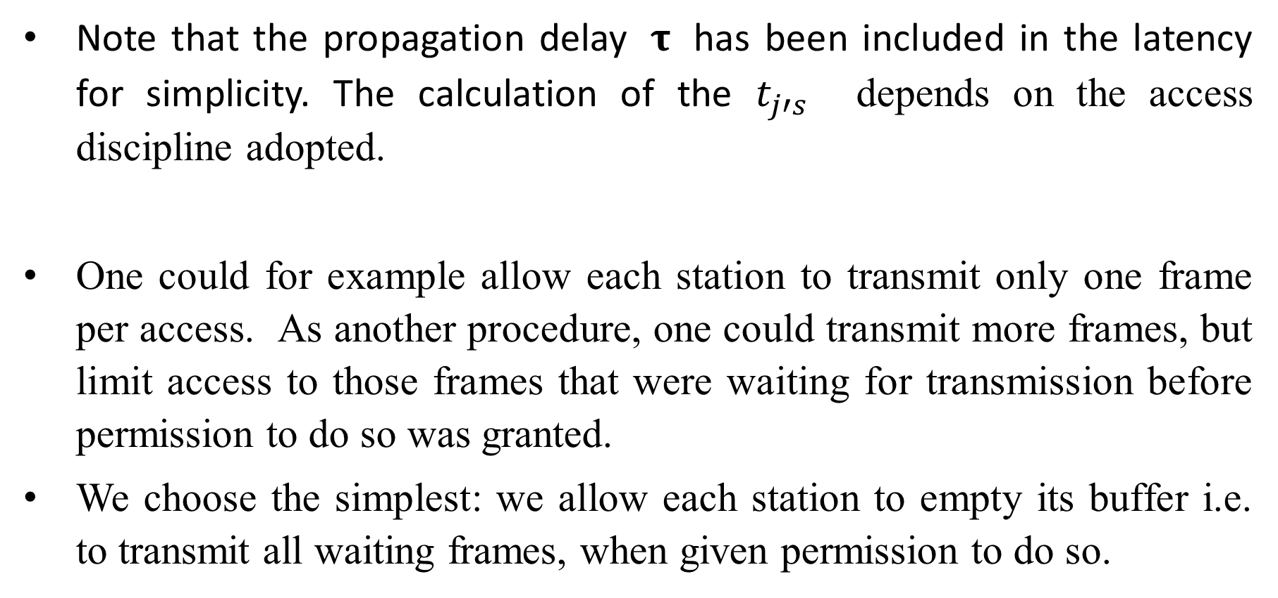
Note that the propagation delay $τ$ has been included in the latency for simplicity. The calculation of the $t_{j′s}$ depends on the access discipline adopted.
One could for example allow each station to transmit only one frame per access. As another procedure, one could transmit more frames, but limit access to those frames that were waiting for transmission before permission to do so was granted.
We choose the simplest: we allow each station to empty its buffer i.e. to transmit all waiting frames, when given permission to do so.

Slide 33
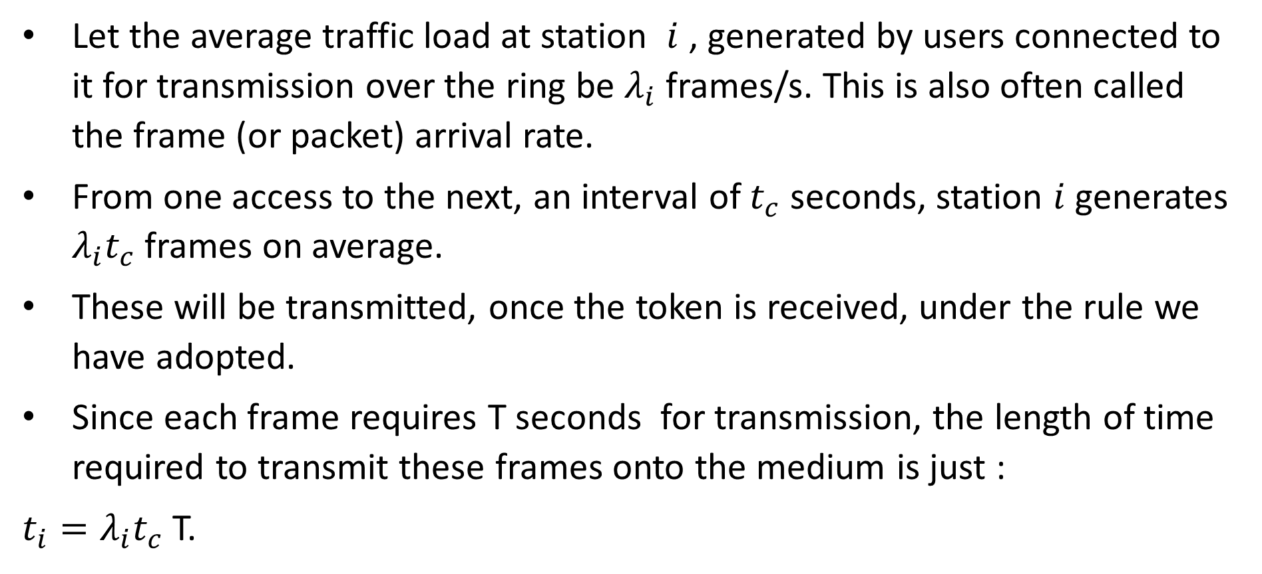
Let the average traffic load at station $i$ , generated by users connected to it for transmission over the ring be $λ_{i}$ frames/s. This is also often called the frame (or packet) arrival rate.
From one access to the next, an interval of $t_{c}$ seconds, station $i$ generates $λ_{i}t_{c}$ frames on average.
These will be transmitted, once the token is received, under the rule we have adopted.
Since each frame requires T seconds for transmission, the length of time required to transmit these frames onto the medium is just :
$t_{i}=λ_{i}t_{c}$ T.

Slide 34

The average cycle time is then:
$t_{c}=L+\sum_{i=1}^{N}{t_{i}}$
Which is
$=L+t_{c}λT$……………………………………equation S

Slide 35
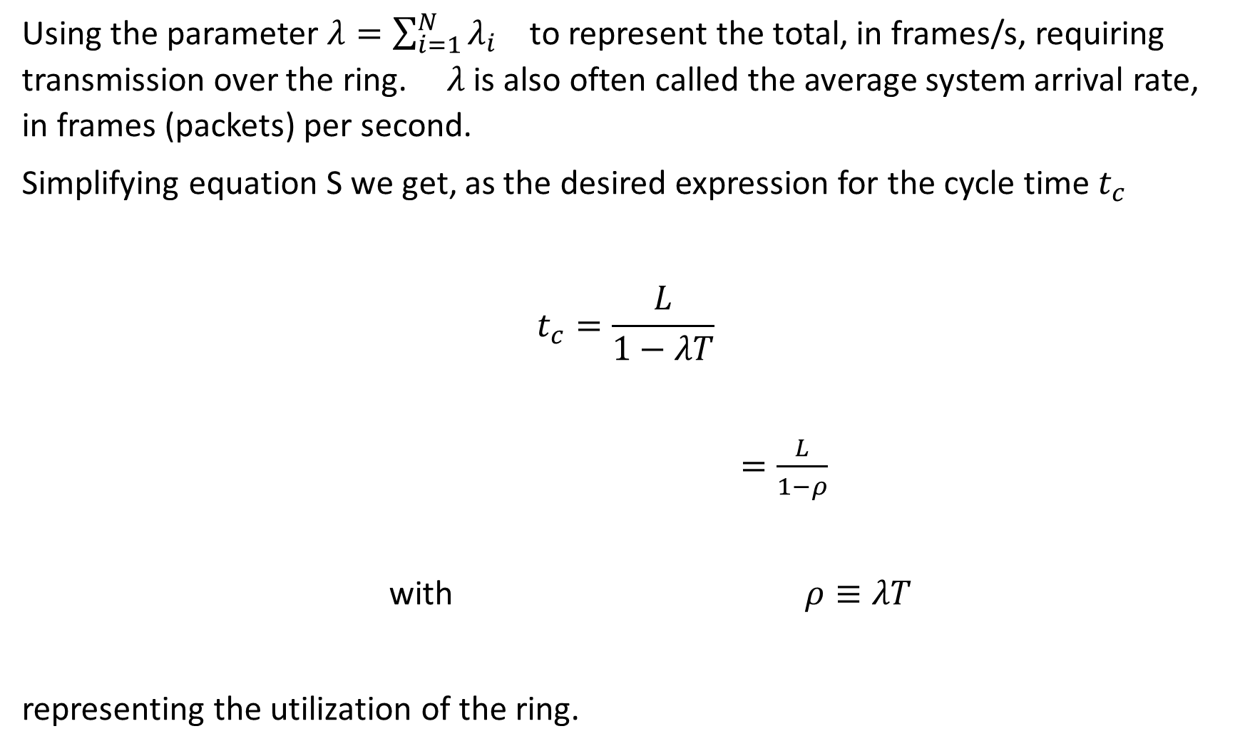
Using the parameter $λ=\sum_{i=1}^{N}{λ_{i}}$ to represent the total, in frames/s, requiring transmission over the ring. $λ$ is also often called the average system arrival rate, in frames (packets) per second.
Simplifying equation S we get, as the desired expression for the cycle time $t_{c}$
$$t_{c}=\frac{L}{1−λT}$$
$=\frac{L}{1−ρ}$
with $ρ≡λT$
representing the utilization of the ring.

Slide 36
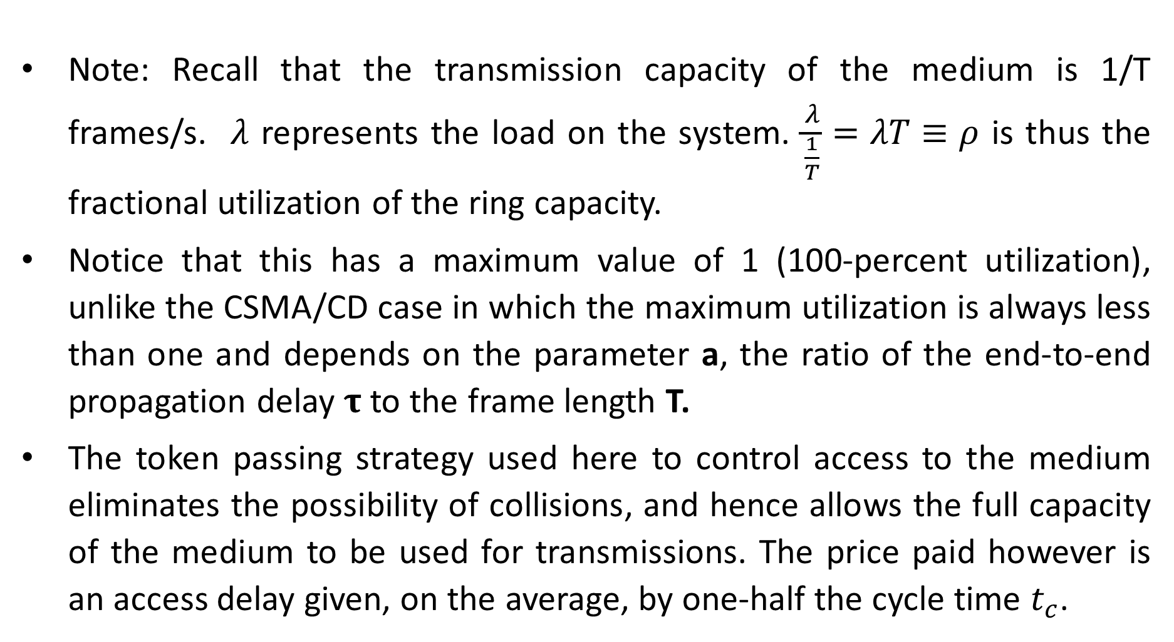
Note: Recall that the transmission capacity of the medium is 1/T frames/s. $λ$ represents the load on the system. $\frac{λ}{\frac{1}{T}}=λT≡ρ$ is thus the fractional utilization of the ring capacity.
Notice that this has a maximum value of 1 (100-percent utilization), unlike the CSMA/CD case in which the maximum utilization is always less than one and depends on the parameter a, the ratio of the end-to-end propagation delay $τ$ to the frame length T.
The token passing strategy used here to control access to the medium eliminates the possibility of collisions, and hence allows the full capacity of the medium to be used for transmissions. The price paid however is an access delay given, on the average, by one-half the cycle time $t_{c}$.

Slide 37
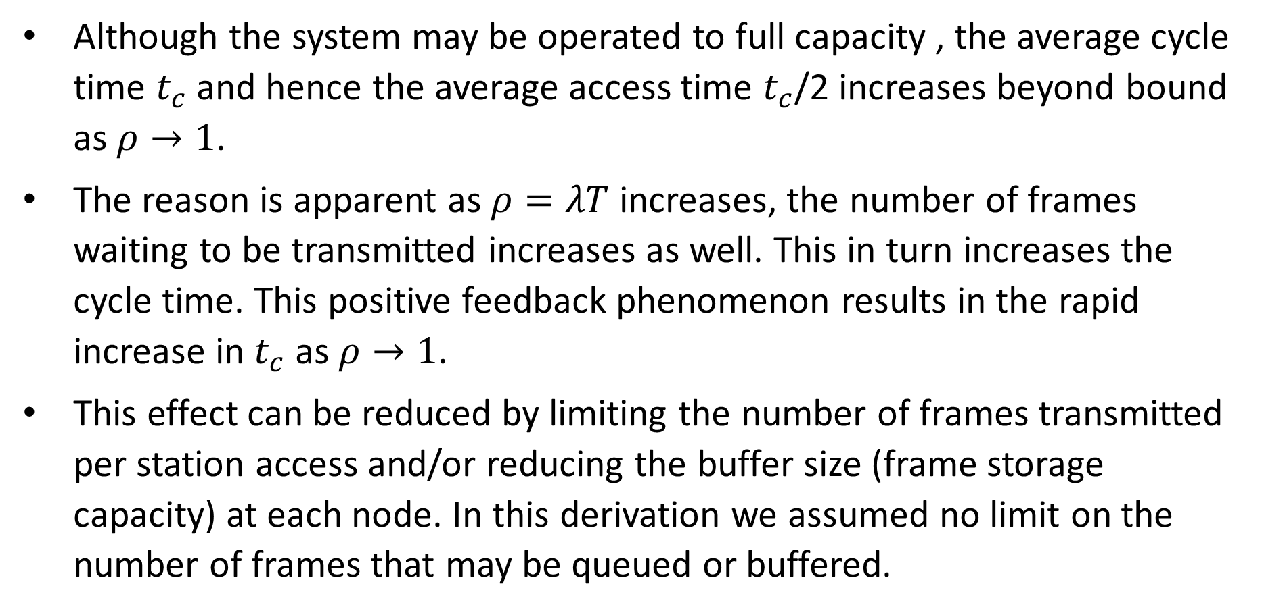
Although the system may be operated to full capacity , the average cycle time $t_{c}$ and hence the average access time $t_{c}$/2 increases beyond bound as $ρ→1$.
The reason is apparent as $ρ=λT$ increases, the number of frames waiting to be transmitted increases as well. This in turn increases the cycle time. This positive feedback phenomenon results in the rapid increase in $t_{c}$ as $ρ→1$.
This effect can be reduced by limiting the number of frames transmitted per station access and/or reducing the buffer size (frame storage capacity) at each node. In this derivation we assumed no limit on the number of frames that may be queued or buffered.

Slide 38
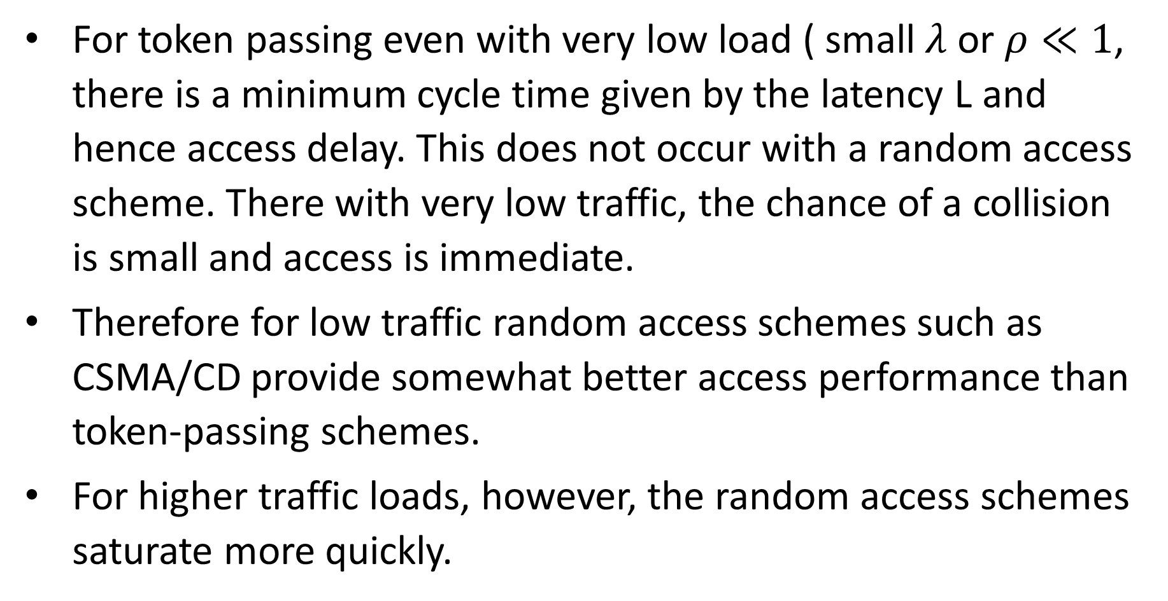
For token passing even with very low load ( small $λ$ or $ρ≪1$, there is a minimum cycle time given by the latency L and hence access delay. This does not occur with a random access scheme. There with very low traffic, the chance of a collision is small and access is immediate.
Therefore for low traffic random access schemes such as CSMA/CD provide somewhat better access performance than token-passing schemes.
For higher traffic loads, however, the random access schemes saturate more quickly.

